Slide 1

SML109 Final Project
Team Artificially Intelligent Dumb
Artem Golubev | Michael Pan | Rachel Mak | Matthew Tati | Koorosh Lohrasbi
Notes:
Thanks Everyone,
We are Artificially dumb and we are going to prove it to you.
We looked around for project, something that was beneficial to us in learning also something that was the need of the market.
Its been a a few decades that we are trying to understand the machine language and hence we have lots of programming languages, we think its about time to get machines to understand our language.
This presentation is about NLP or …. Focusing on one specific and simple use case.

Slide 2

A SOUND FUTURE
Notes:
Whooshkaa is an amazing Australian startup which is disrupting the radio business globally. They use podcasts, audio-on demand and other forms of audio to replace traditional radio streaming.
We reached out to them to see if there is any oportunity to solve their problems using ML and DL.
We came up with a list of potential projects which could benefit from some machine learning.

Slide 3

Opportunities
Podcast Classification
Sentiment Analysis
Personalised News/podcasts
Profanity Detection
Smart Ad Injection
Podcast Summarisation
Notes:
So there were a lot of opportunities where ML/DL could have meaningful value for Whooshkaa.
Here are some examples of what a roadmap can look like.
For example, personalised news and podcasts are all the rage, just imagine you wake up evenry morning and your personalised news feed or podcasts would be read to you.
Or if there is a podcasts about dogs, there should be ads about dogfood. That’s the smart ad injection.

Slide 4

Minimum Viable Pro(ject)
Notes:
But all of the those interesting use cases pivot around one hinge, understanding what is inside these podcasts, audio-on-demands and news articles.
This is where NLP and NLU come to the picture.
So as the first minimum viable project we selected text or voice classification of different podcasts into main categories.
Due to short time and to simplify our problem we focused on text version of these podcasts rather spending time on turning voice into text.

Slide 5

Noun Phrase Chunking
Noun Phrase Chunking
NP Chunking
NP Chunking – Consecutive NP Chunker based on IOB tagger
IOB Tagging – MaxentClassifier with custom feature extraction
Notes:
Noun Phrase Chunking is a way to extract the important building blocks of a sentence with the intent of categorising a sentence into a certain class.
We split the text into senteces and senteces into words.
And we tag every word with its part of speech tag.
And then feed it into a pre-trained model to classify every word as in or out or the beginning of a noun phrase. It is called IOB tagging.
At the end we have a long list of phrases.

Slide 6
Non-negative Matrix Factorisation
Notes:
To extract the more meaningful parts of an article we should reduce the dimensionality of the input.
Non-negative matrix factorisations could be used as a dimensionality reduction method using simple clustering. Needless to say this is an unsupervised method.
The input or data matrix counts each row as a document, and each row represents a word. The number of times each word appears in each document is input as an entry. The goal of NMF is then to find two matrix factors which multiply to produce the closest approximation to the data matrix. We use a coordinate descent algorithm to find the solution iteratively, until the distance between the factor products and the data matrix is a minimum as measured by their cost function.
The most important input in NMF is the number of topics (or clusters), which is not known a priori. This number is typically much smaller than the number of words, giving dimensional reduction.

Slide 7

Word2vec & Convolutional Neural Networks
Training Data
Reuters 21578 Dataset
Articles → Labels
Labels:
Sports, Regional, People
Politics, Technology
Method
Wordtovec as Feature Extractor (NLTK)
CNN
Con1D -> Con1D -> AveragePooling1D -> Con1D -> Con1D -> Flatten -> Dense -> Output
Accuracy: 92.14%
Keras on AWS EC2 p2.xlarge
Notes:
We also wanted to dip our toe into Neural Nets and see what could we do with Convents.
We used Reuters dataset which has a huge amount of already ladled articles and the goal was to categorise articles into 5 main categories.
Sports, Regional, People, Politics and technology.
We decided to use NLTK and Word2vec to extract features from the articles and then feed them into a CNN model.
Here is the architecture of the CNN model.
We ran everything on Keras on top of an AWS p2.xlarge instance and the accuracy result was 92% which was good enough for us.
A fun fact: the total cost of training on AWS was 3 cents.

Slide 8

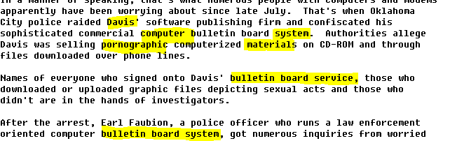
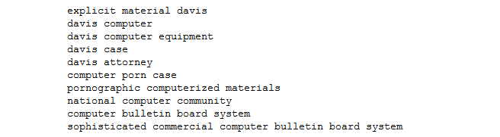
Results

Slide 9

Lessons Learned

